Slide 1
AICT IBM PROJECT TRACKING MATERNAL HEALTH PROGRESS TOWARD SDG 3.1
Presented By:
MOHAMMAD ARSHAD
College Name : Mesco Institute of Management and Computer Science
Department : Master in Computer Application (MCA)

Slide 2
OUT LINE
Problem Statement()
Proposed System/Solution
System development Approach()
Algorithm & Deployment
Result()
Conclusion
Future Scope
References

Slide 3
Problem Statement
The Sustainable Development Goal 3.1 aims to reduce the global maternal mortality ratio to less than 70 per 100,000 live births by 2030. Monitoring progress towards this goal requires analyzing country-wise data on maternal mortality and associated health indicators such as antenatal care coverage, births attended by skilled personnel, adolescent birth rates, and healthcare expenditures. Despite global efforts, maternal health outcomes vary drastically between regions and income groups, raising the need for data-driven insights into the factors influencing maternal health.

Slide 4
Proposed Solution
I address the challenge of predicting the time period of the Maternal Health Tracking3.1 SDG. In Machine Learning Technique to forecast demand pattern accurately. The Solution will consist of following components.
Data collection:
Gather the data of time period including area ,sector ,subgroup and other factors.
Gather the data source, such as births per year, analyzing country wise data etc.
Data preprocessing:
Clean and preprocess the collected data to handle missing values outliers and inconsistences.
From the given data we may get the time period of the table at what consistency.
Machine learning Algorithm:
Implementing a machine learning algorithm such as time series Forecasting analysis model, to predict the time period
pattern.
Consider every year of the factors that decide the time period to predict the accuracy.
Deployment:
Develop the user friendly interface of application the provide real time prediction for time period.
Deploy the solution on a scalable and reliable platform

Slide 5
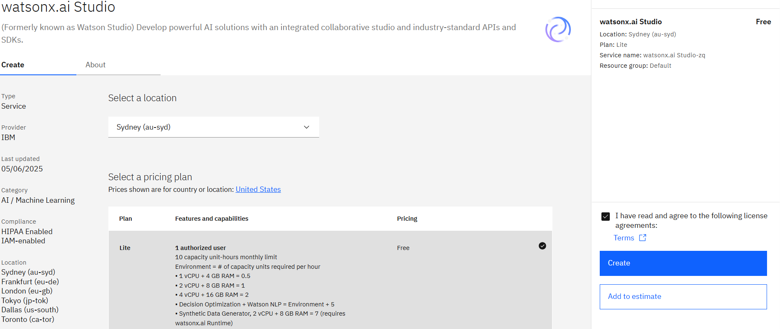
System Approach
The section outline the Overall strategy ad methodology for Developing and implementing the time period prediction system. Here a suggested structure for this section
System requirements
Library required to build the model
IBM watsonx.ai studio
IBM Runtime machine

Slide 6
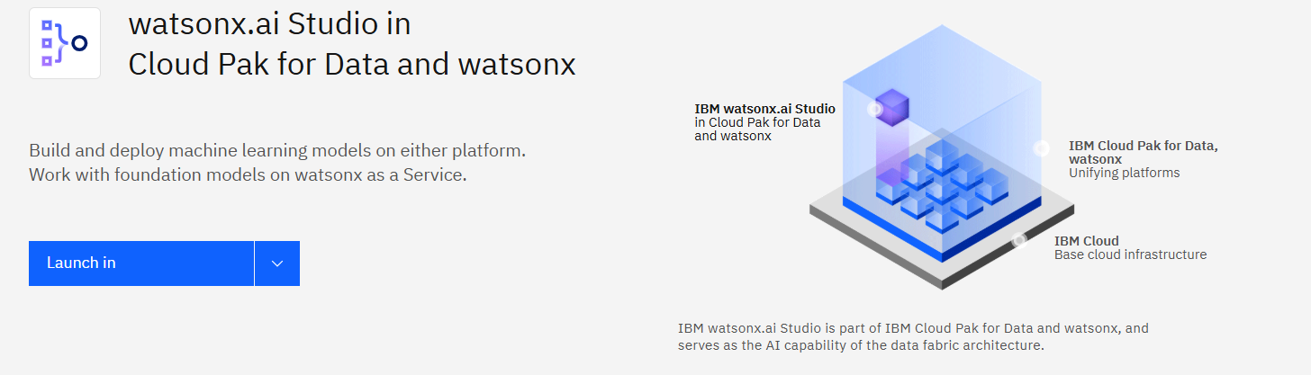
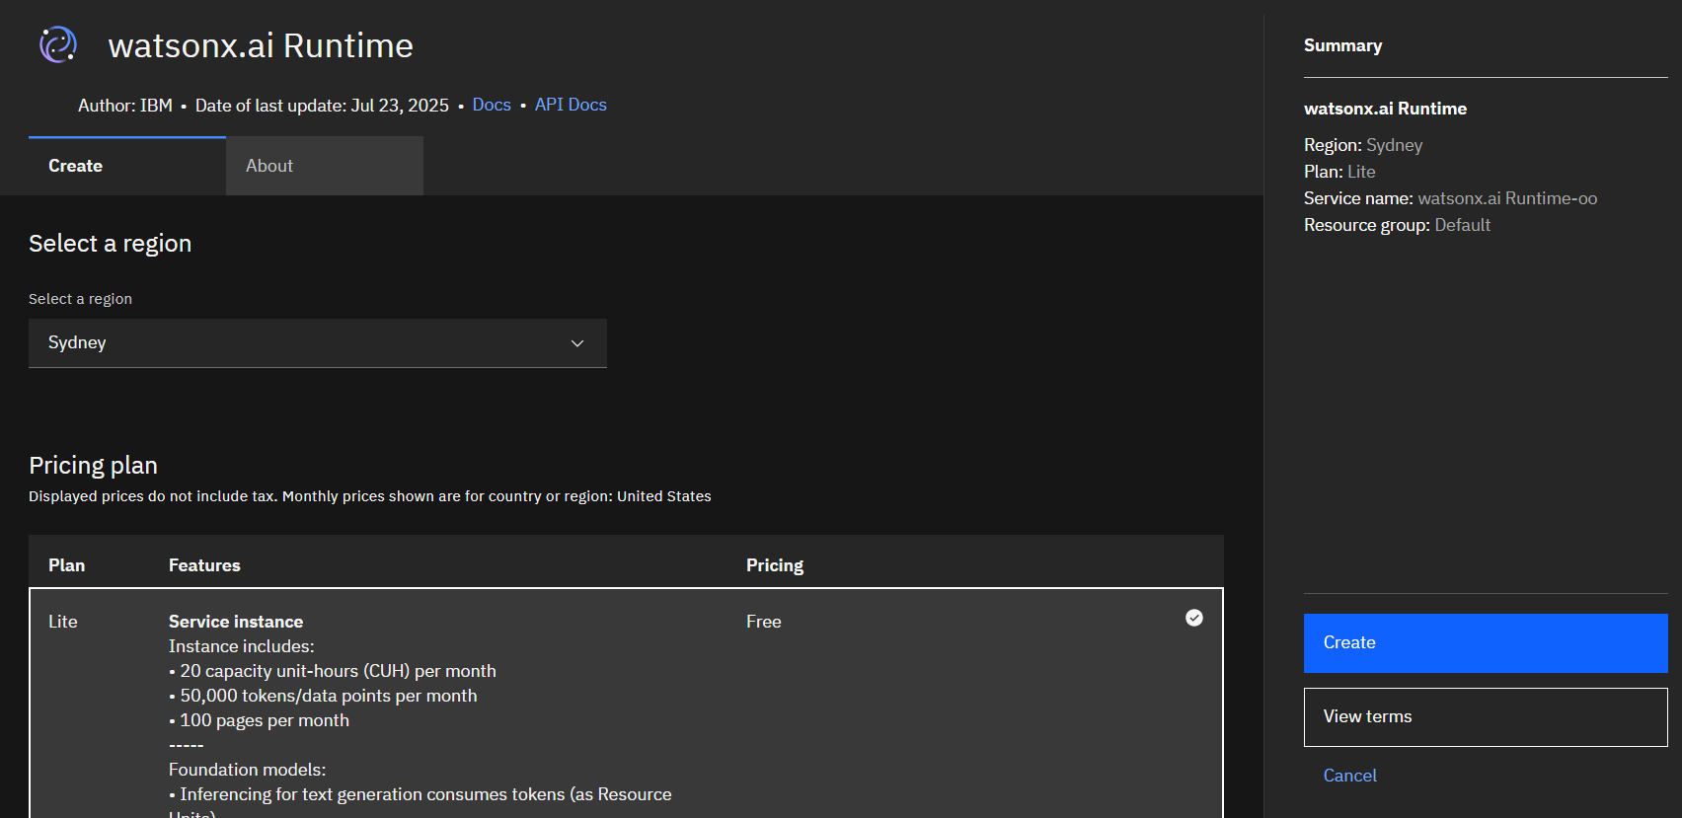

Slide 7
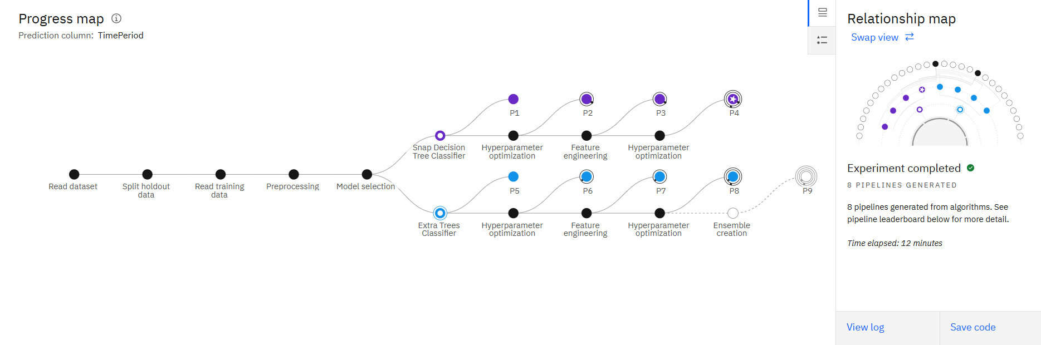
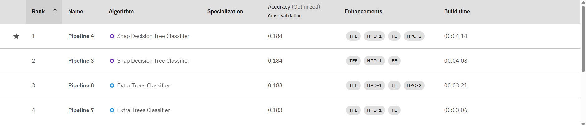
Algorithm & Deployment
Describing machine learning algorithm chosen for predicting the time period.
Algorithm section:
I have choose the time series forecasting model is LSTM on
problem statement and data characteristics.
Data input:
The input features used in the algorithm is area sector
subgroup, indicator etc.
Training process:
The algorithm is trained for Time period of the statement in
the hyperparameter tuning.
Prediction process:
I was used the time period for the predicting the Health
tracking process

Slide 8
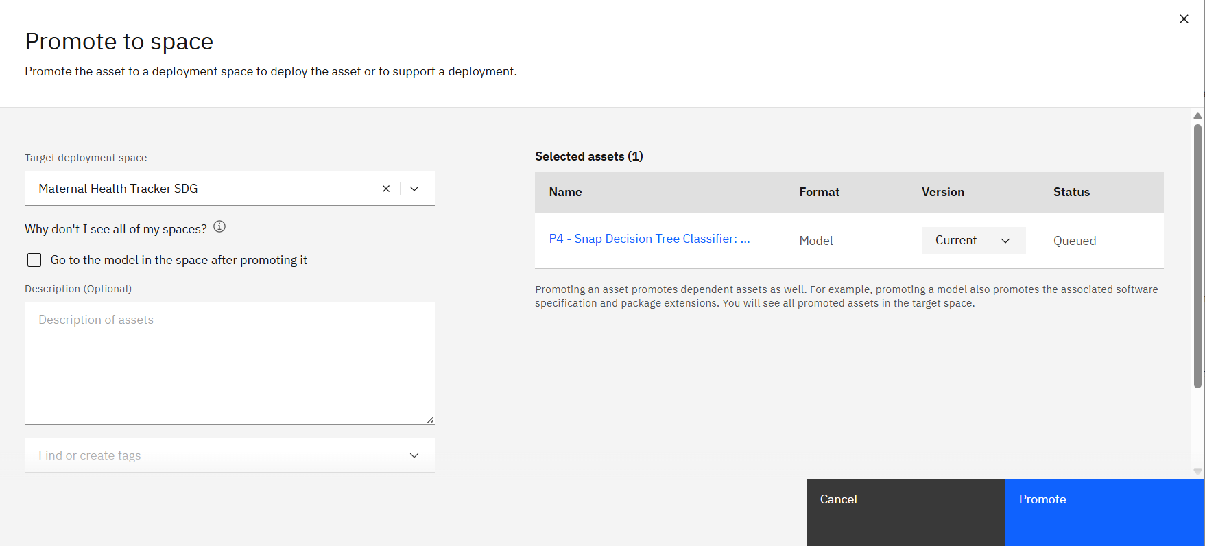
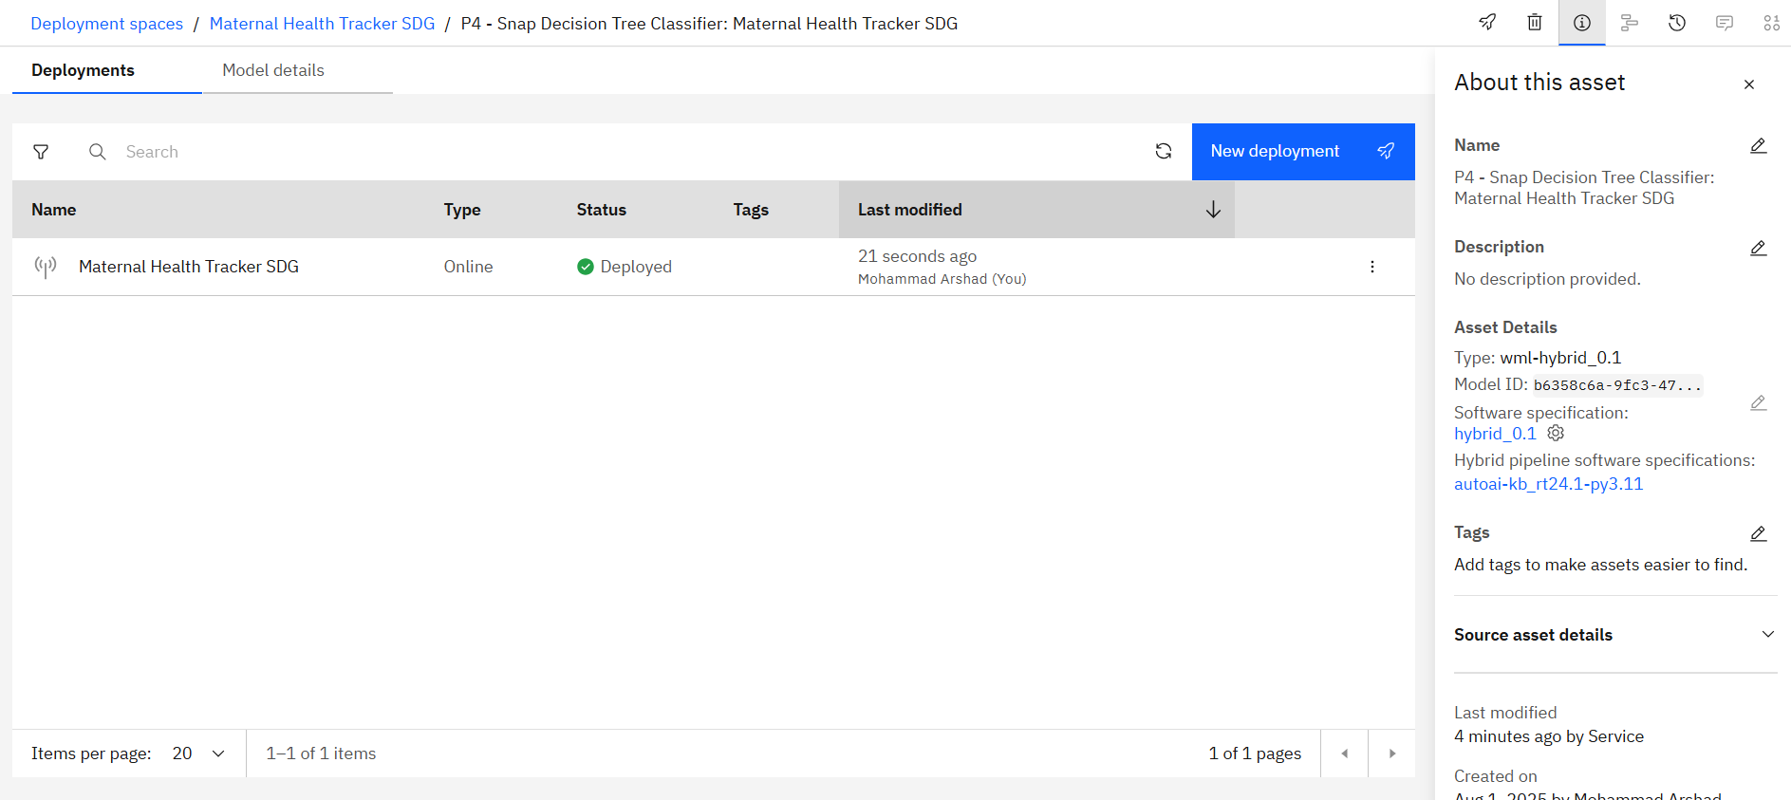

Slide 9
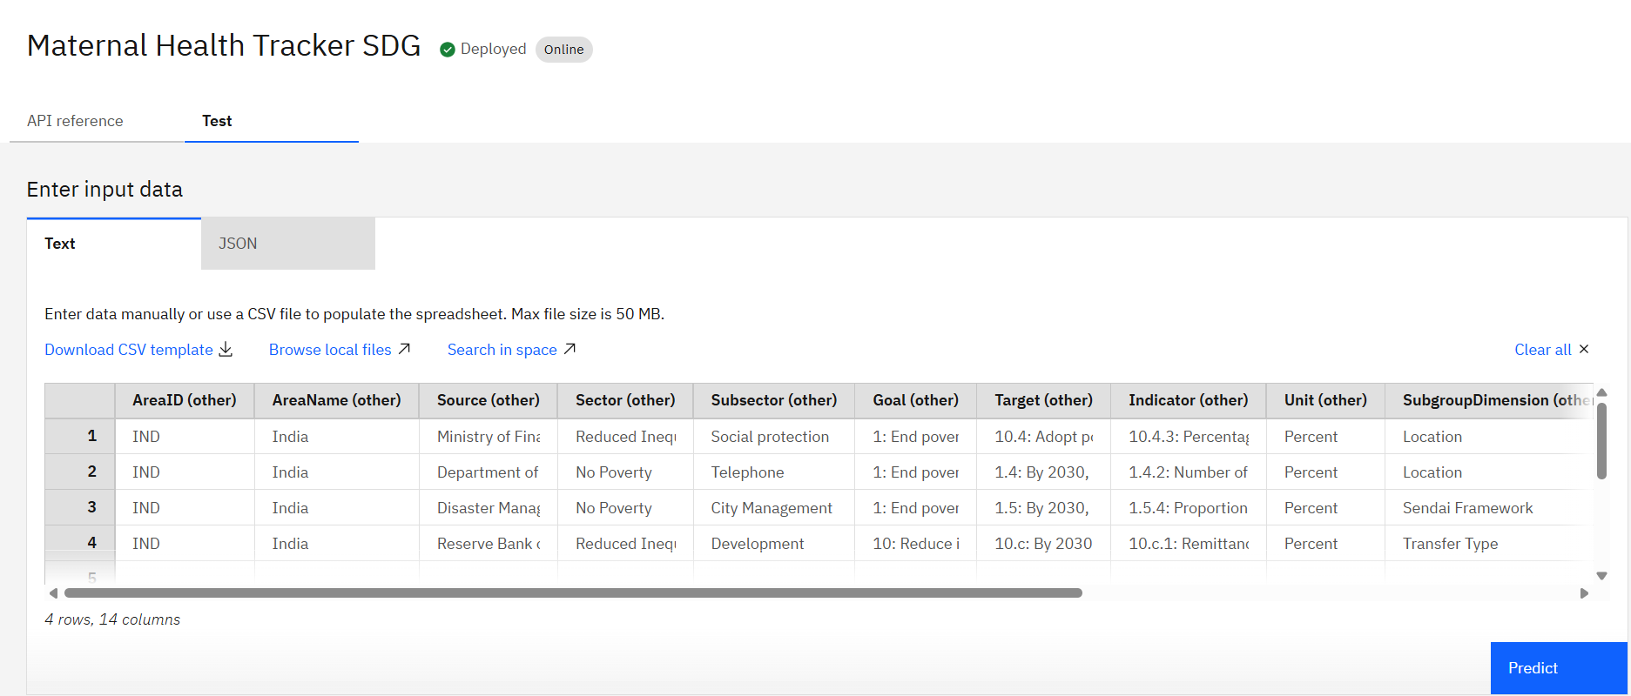
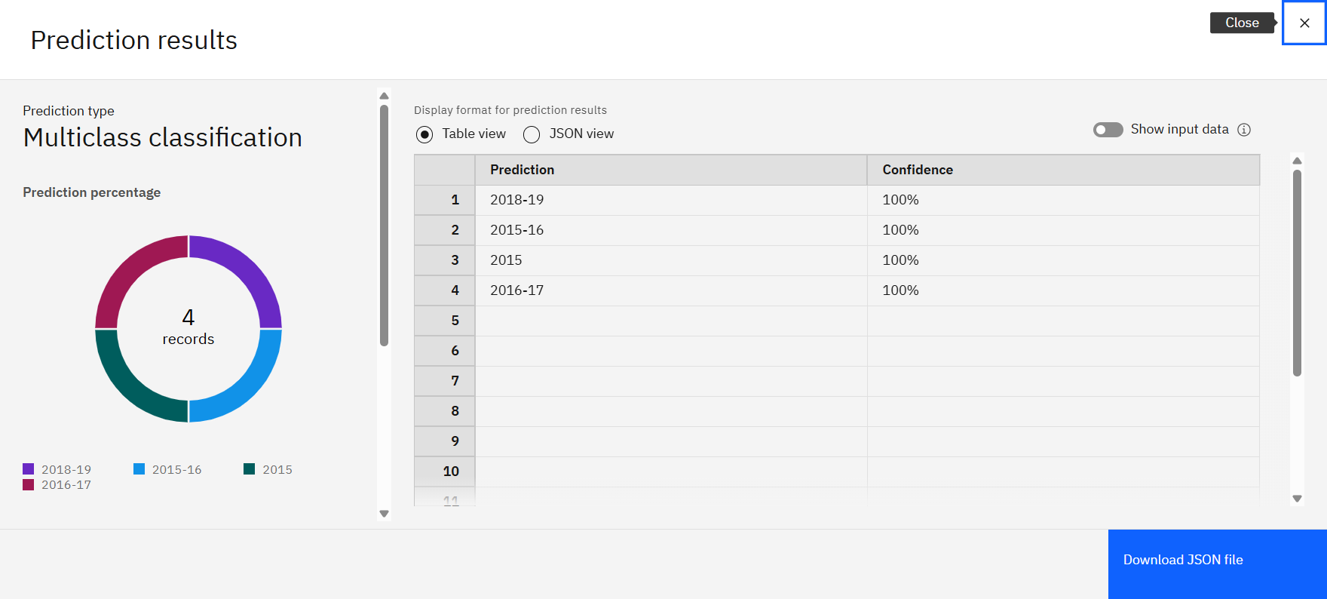
Result
By the machine learning model I find the accuracy and effectiveness in predicting Time period. In the Maternal Health Tracking SDG.

Slide 10
Conclusion
While global maternal morality has declined the rate of reduction has slowed and significant disparities persist between high income and low income countries. The data clearly show that regions like sub-Saharan and Asia the birth rates. Therefore, achieving the 2030 target requires a renewed and targeted commitment to strengthening healthcare systems, particularly in the most vulnerable regions, by increasing access to and quality of maternal health services, improving reproductive education, and investing in skilled health personnel.

Slide 11
Future Scope
The future scope of data-driven insights for improving maternal health and achieving SDG 3.1 is vast and centers on the integration of advanced technologies. Here are some key areas for future development
AI-Powered Predictive Analytics
Remote Monitoring with Wearable Technology
Personalized Care Plans
Telemedicine and Digital Health Platforms

Slide 12
References
World Health Organization (WHO), UNICEF, UNFPA, World Bank Group and the United Nations Population Division are the key agencies that collect and publish data on maternal mortality and related health indicators. Their joint report, "Trends in Maternal Mortality," is a primary source for tracking progress towards SDG 3.1. Additionally, the WHO's Global Health Observatory (GHO) provides country-specific data on various indicators, including the maternal mortality ratio, antenatal care coverage, and births attended by skilled health personnel. The World Bank also publishes data on health expenditures and other socioeconomic factors that influence maternal health. These sources offer detailed, regularly updated information crucial for data-driven analysis of maternal health outcomes.

Slide 13
GITHUB LINK : https://github.com/arshad-30/Maternal-Health-Tracking-SDG/upload

Slide 14
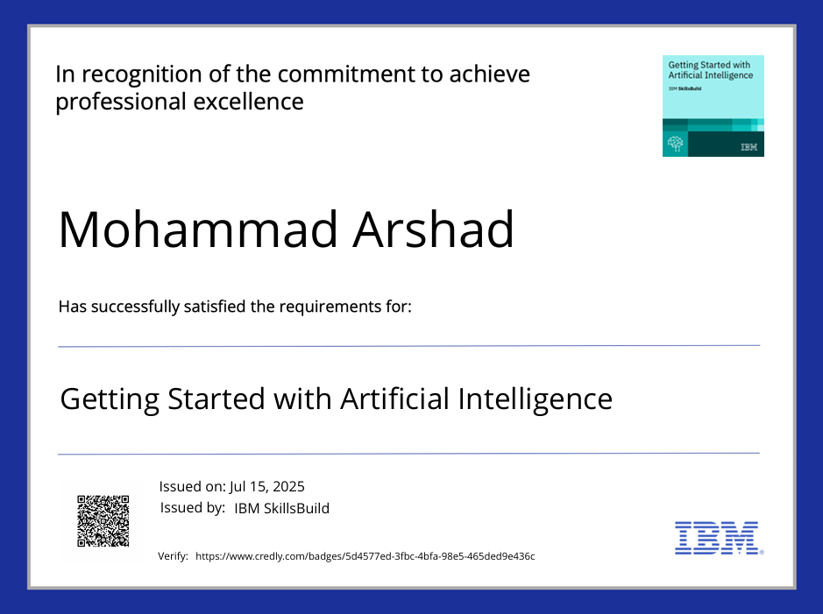
IBM Certification

Slide 15

IBM Certification

Slide 16
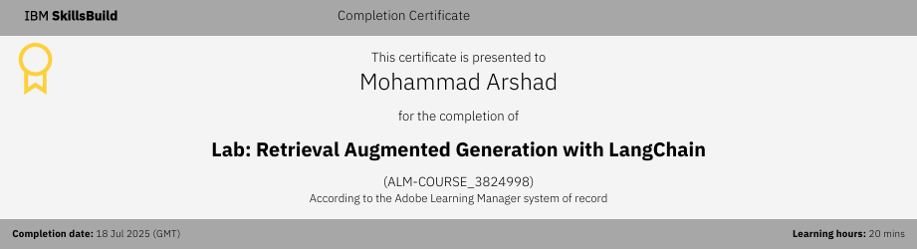
IBM Certification

Slide 17
THANK YOU

